Slide 1
Confidence intervals
HOTEL MANAGEMENT SCHOOL MAASTRICHT

Slide 2



In statistics, parameters of the entire population
Sampling
Are often estimated based on a sample
The most common parameter you will likely use is the mean

Slide 3
An example (Height)
I want to know the average height of all the 2nd year HMSM students.
But I can’t go around and measure everyone!
So I will sample! How tall are you?

Slide 4
The average

Slide 5
What would happen if we added more samples?
Because the mean changes with each new sample, we can easily say that the mean of the whole population is likely different than the sample.

Slide 6

Whole population µ
Each sampling is likely to lead to an outcome with a different mean.
Sampling 1
Sampling 2
Sampling 3
How can we be accurate?
It’s useful to use a range of numbers in which the true value will fall with a high probability
This range is called the
CONFIDENCE INTERVAL

Slide 7
But what is a high probability?
You get to choose! Normally we use 95% or 99% probability.
This means you are 95% (or 99%) sure the true mean is contained in your range of numbers.

Slide 8
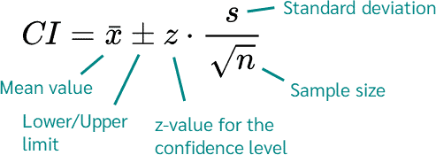
How do we calculate it?

Slide 9
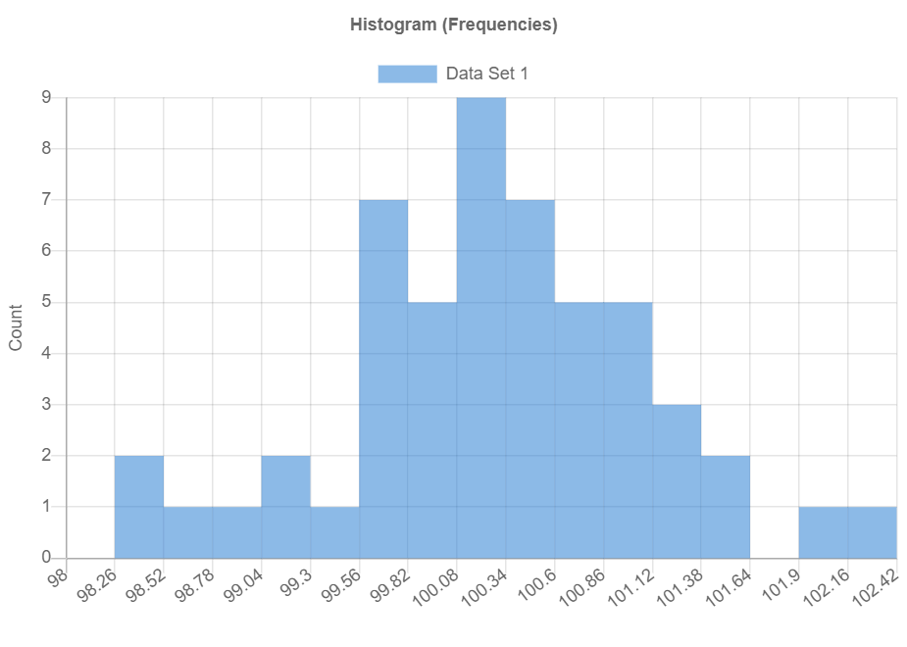
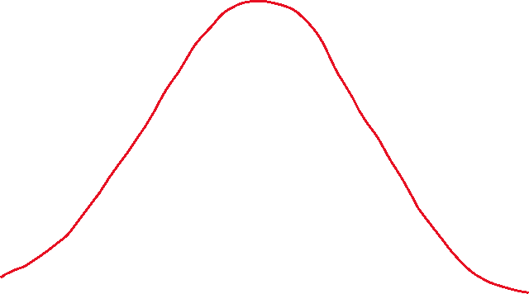
How can we visualize this?
CI=100 ± 1.4

Slide 10
Let’s calculate based on our Data

Slide 11
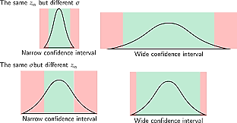
How can we make a confidence interval more Precise?
So we want this: 100 ± 1.4
Sample size makes a huge difference!!
Rather than this: 100 ± 25

Slide 12
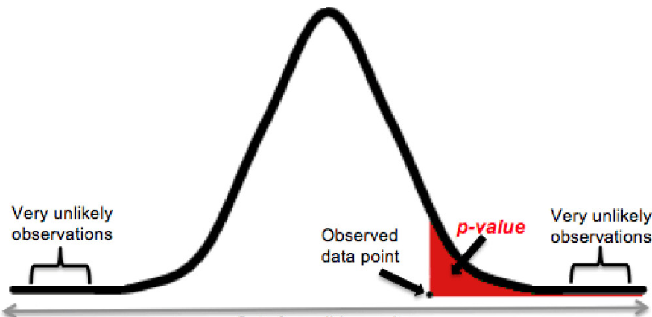
And what is a p-value?

Slide 13
The takeaways
Be able to define:
point estimates
the mean of your sample
confidence intervals
a range of numbers in the true mean falls with a high probability
degree of certainty or confidence level
the high probability that you define (95% or 99%)
Significance
100-(degree of certainty)=significance
‘one-tailed' or 'two-tailed tests
do you only care if there is a difference? Or do you want to know if something is greater than or less than
Why do we use confidence intervals?
What does a p-value of 0.05 mean?

Slide 14
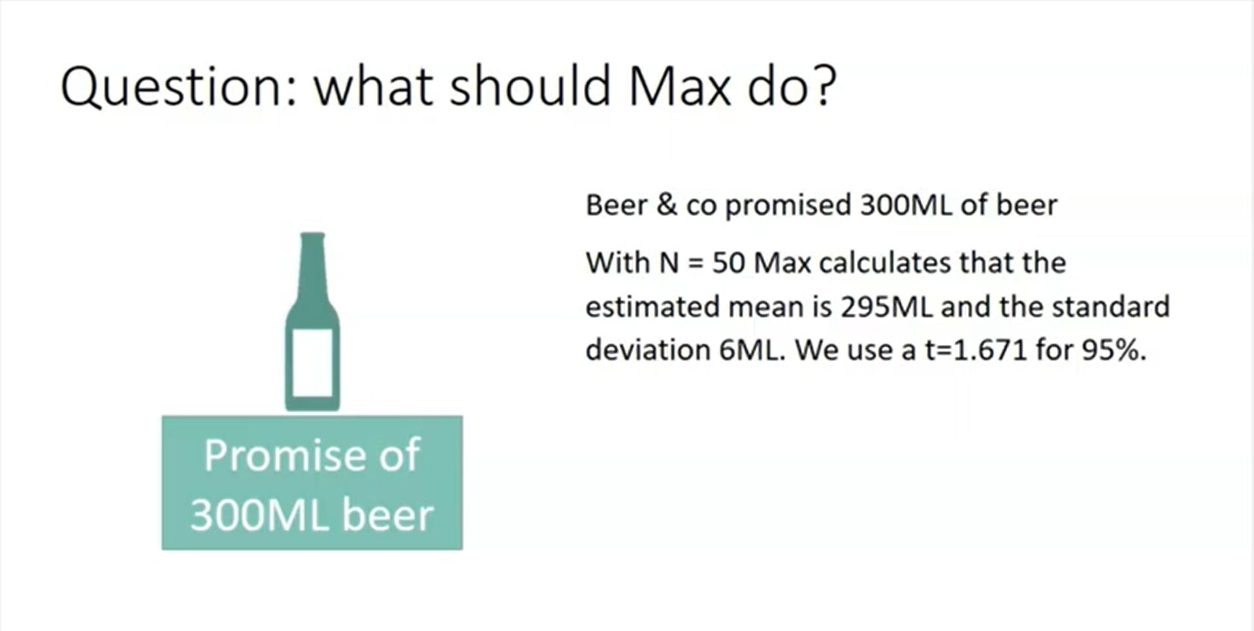

Slide 15
